Slide 1
Health and Social Care Cambridge Technicals Knowledge Organiser
Unit 4:
LO5: The control and regulatory systems, malfunctions and their impact on individuals.

Slide 2
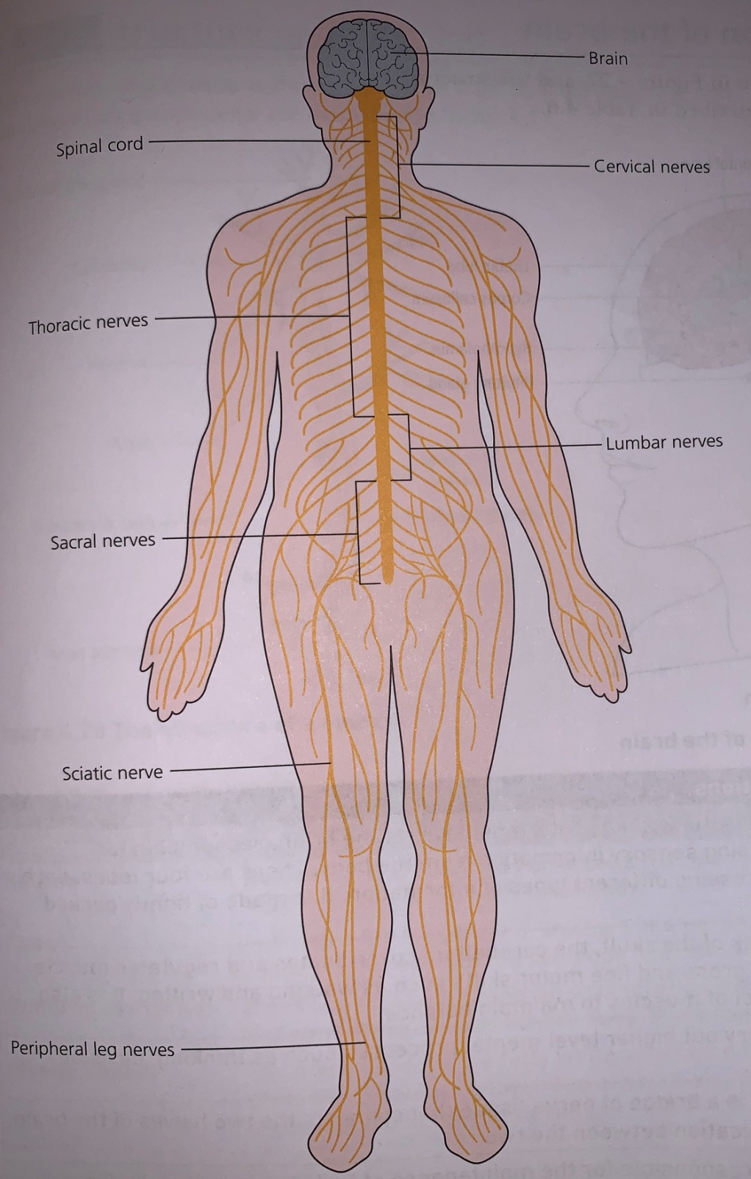
Components of the nervous system
Component | Structure and Function
Central nervous system | The control centre for the body- consisting of the brain and spinal cord. The spinal cord connects to the brain – long lines of individual never cells to all areas of the body.
Spinal cord | Protected by specialist bones – vertebrae. These bones have a hollow centre and the spinal cord runs through these. The spinal cord transmits information to and from the brain through structures called nerves.
Autonomic system | Controls and regulates processes like the heart rate and gut movements (peristalsis). These actions are automatic (unconsciously controlled)
Sensory and motor neurones (somatic nervous system) | Sensory nerves transmit information from the senses – the eyes, ears etc. to the brain. Motor nerves transmit information to the muscles from the brain. Sensory and motor nerve pathways work together – for example, when picking up an item like a pen.
Peripheral nervous system | All nerves outside the central nervous system make up the peripheral nervous system. Relays information from the brain and spinal cord to the rest of the body and the reverse information from the body to the brain and spinal cord. Peripheral nerves include autonomic, sensory and motor nerves.

Slide 3
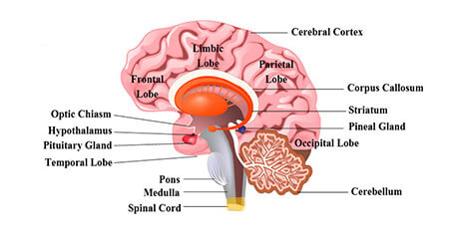
Anatomy and structure and function of the brain
Component | Structure and Functions
Cerebral cortex | Cerebral cortex is wrinkly, outermost layer of the brain – responsible for thinking and processing sensory information from the body. 4 lobes, each one responsible for processing different types of information. Made up of tightly packed neurons.
Cerebellum | Located at the back of the skull, it coordinates and regulates muscle activity. Example – fine an d gross motor skills like writing and walking. Also involved in controlling muscles to maintain balance.
Frontal lobes | Carry out higher level mental processes like thinking, decision making and planning.
Corpus Callosum | A bridge of nerve tissue that connects the two halves of the brain and enables communication between the two.
Hypothalamus | Responsible for maintaining body temperature. Also regulates appetite and thirst – letting us know when we need to eat and drink.
Medulla | Automatically carries out and regulates life sustaining functions like breathing, swallowing and heart rate.
Meninges | Three layers of membranes surrounding the brain and the spinal cord. They provide a barrier form the rest of the body and act as protection from infection.
Exam Tips:
You must know the structure and function of the nervous system and brain and be able to label diagrams and describe the functions of components.

Slide 4
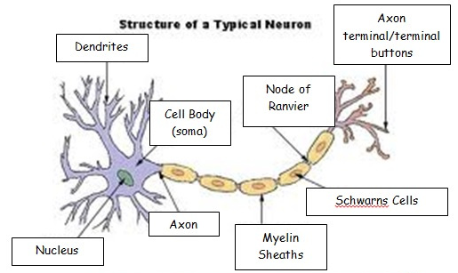
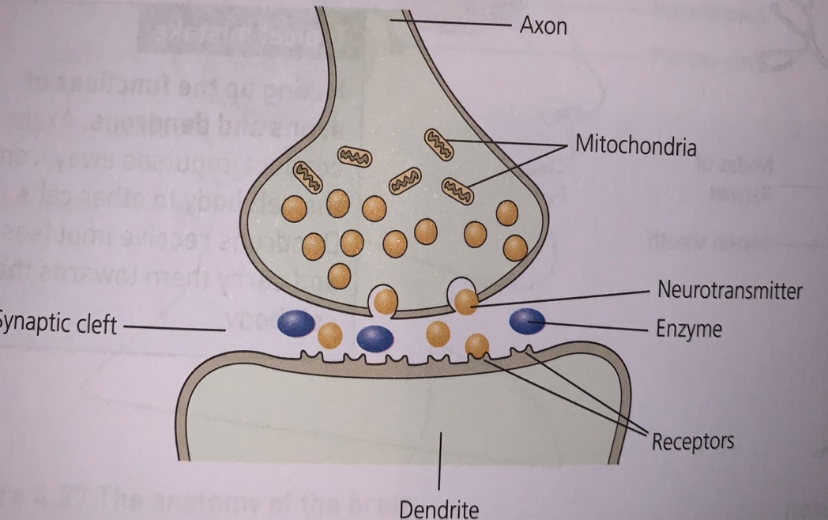
Neuron structure and function
Structure and function of a synapse
Component | Structure and Functions
Neuron | Neurons are specialised nerve cells that transmit electrical impulses (information) from one part of the body to another.
Axon | Long thread-like part of a nerve cell. Impulses are conducted away from the cell body to other cells. There is only one per neuron.
Dendron (Dendrite) | Short, branched structures on the neuron that receive electrical impulses and carry them towards the cell body. There can be as many as 1000 per neuron.
Myelin Sheath | The myelin sheath is a fatty white substance that surrounds the axon – form a protective, insulating layer and enables electrical impulses to transmit quickly and efficiently along the nerve cells.
Information flows from one neuron to another across a synapse. The synapse has a small gap separating neurons.
Synapse consists of three elements:
Pre-synaptic membrane
Post-synaptic membrane
Gap between the two membranes – called synaptic cleft.
The function of the synapse is to transfer electric activity from one cell to another:
Electrical impulse travels along an axon
Triggers the nerve-ending of a neuron to release a chemical messengers called neurotransmitters
Chemicals diffuse across the synapse (the gap) and transmit signals
They bind with receptor molecules on the membrane of the next neuron.

Slide 5
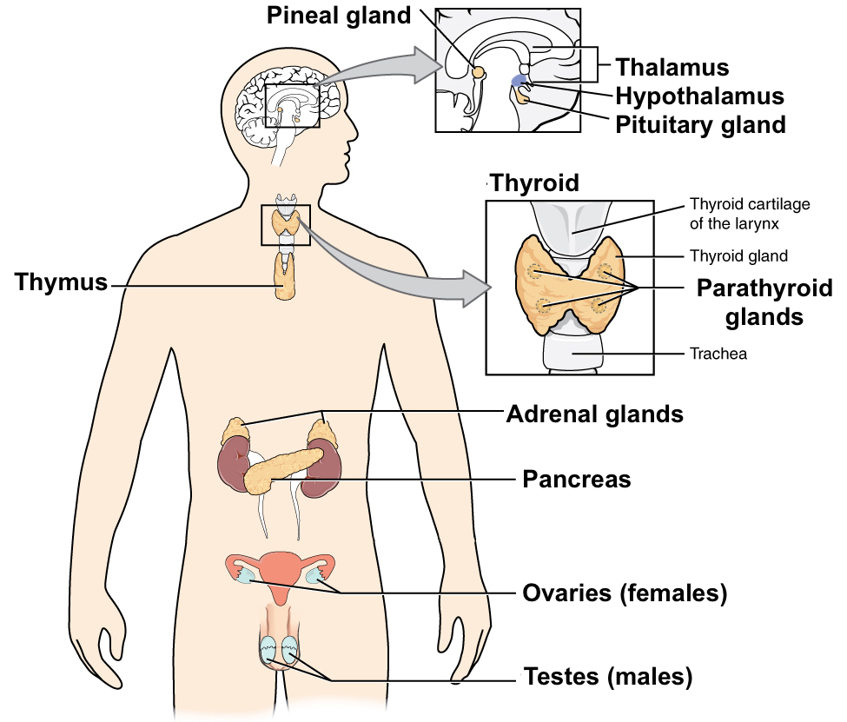
The Endocrine System – organization and function.
Hormones: The chemical substances that regulate the activity of cells or organs. The bloodstream transports the hormones around the body to maintain the function of different organs
Gland | Functions
Pancreas | The pancreas – gland situated near the stomach that produces insulin. Insulin is needed to control glucose (blood sugar) levels in the body.
Pituitary | Located at the base of the brain – it is the ‘master gland’ and regulates all other endocrine glands.
Adrenal | There are two adrenal glands – one on top of each kidney. They produce adrenaline – the ‘fight or flight’ hormone. It is released into the bloodstream as a response to threat and prepares the body to fight or run by raising the heart and breathing rates.
Thyroid | Located in the neck on the lower front part – produces thyroxine, which affects growth and sustains metabolism, basically how the body functions.
Ovaries and testes (reproductive glands) | Ovaries and testes are the source of the sex hormones. Testosterone – affects male characteristics like; sexual development, facial hair growth, puberty changes and sperm production. Ovaries produce oestrogen, progesterone and eggs – the hormones control breast growth and reproductive functions like menstruation and pregnancy.

Slide 6
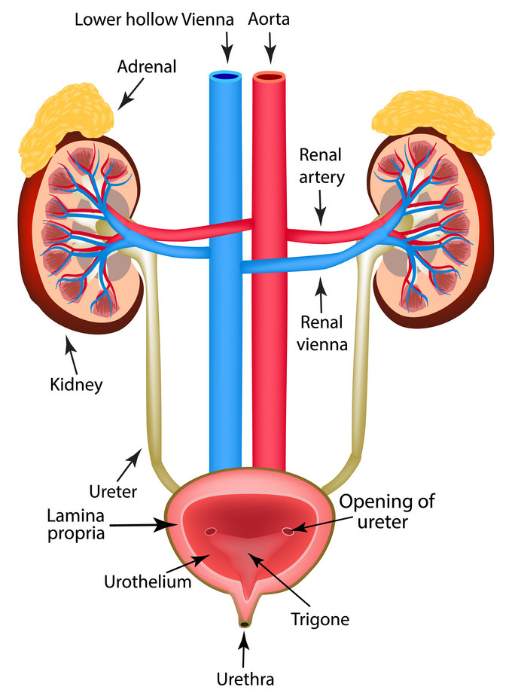
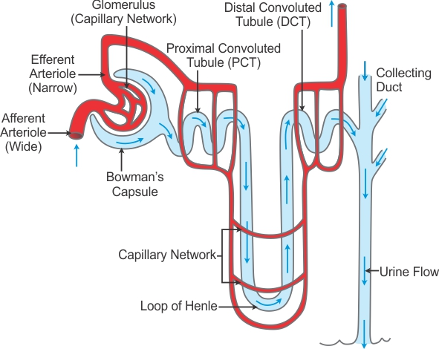
Kidney structure
Function of the Kidney:
The kidney has two main functions, both are carried out by the nephrons (see diagram below).
These are:
the removal of urea (waste)
and the maintenance of the balance of water levels.
The kidneys maintain the body’s water balance (osmoregulation) by controlling the water concentration od the blood plasma – keeps the water we drink and water loss constant.
Kidneys control salt levels and the excretion of water – water not put back into the blood is excreted as urine.
Nephrons are ball of small capillaries known as a glomerulus and a small tube called a renal tubule.
Ultrafiltration – when metabolic wastes are separated from the blood and urine is formed. This happens in the glomerular capsule (Bowman’s capsule in the nephron)
After filtration, kidneys selectively reabsorb molecules that the body needs, including; glucose, mineral ions(salts) – reabsorbed in the proximal and distal tubes. As well as much water as the body needs which is reabsorbed through the loop of Henle.
Left kidney
cortex
medulla
Renal pelvis
Nephron Structure
bladder
Kidney components:
Cortex – outer layer of the kidney.
Medulla – inner region and contains thousands of nephrons.
Renal artery – supplies blood to the kidney.
Renal vein – carries blood filtered by the kidney.
Calyx – urine passes through the chambers.
Ureters – tubes that carry urine from the kidney to the bladder.
Bladder – stores urine.
Urethra – urine passes out of the body through this.

Slide 7
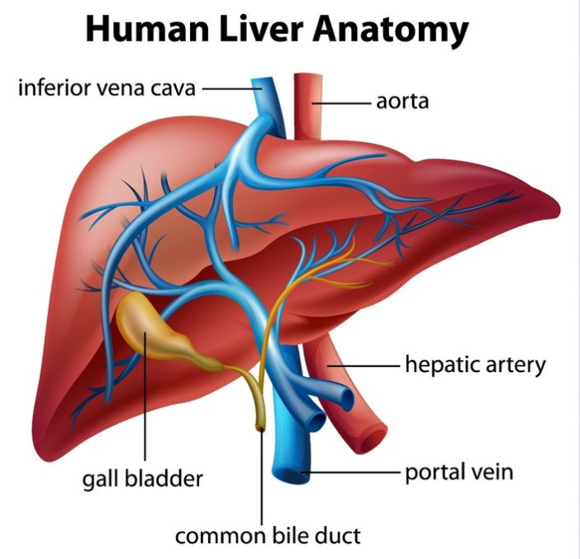
Breakdown functions – the liver and homeostasis
Homeostasis concept:
Homeostasis is the maintenance of a constant internal environment – the conditions in the body need to be controlled carefully so that it functions effectively. The nervous system and hormones are responsible for this.
Homeostasis Examples:
Concentration of carbon dioxide in the blood.
Body temperature being maintained at 37◦C because enzymes work better at this temperature.
Blood sugar levels – controlled by the release and storage of glucose – this is in turn controlled by insulin.
Water content – protecting cells by preventing too much water entering or leaving.
Negative Feedback:
Homeostatic control is achieved by using negative feedback mechanisms:
If the level of something rises – control systems reduce it again.
If the level of something falls – control systems raise it again.
The liver is the largest internal organ in our bodies and carries out more chemical processes than any other organ in the body!
Deamination:
occurs in the liver during protein metabolism (breakdown).
results in the production of ammonia, which is toxic waste.
Detoxification:
liver converts ammonia produced by deamination into urea – this is still waste, but less toxic.
Urea transported in the blood and removed by the kidney in urine.
Liver breaks down alcohol, removing it from the blood.
Also breaks down drugs like paracetamol.
Production of Bile:
Bile produced by the liver as a result of the breakdown of red blood cells.
Bile stored in the gallbladder until needed by the digestive system.
Bile emulsifies fats during the digestive process.
Concentration of blood glucose increases above the norm after a meal.
Too much glucose in the blood – negative feedback from the pancreas.
Pancreas secretes more insulin – pancreas is the effector.
Liver and muscles convert excess glucose to glycogen and store it.
Concentration of blood glucose returns to normal.
Example – homeostasis regulating blood glucose

Slide 8
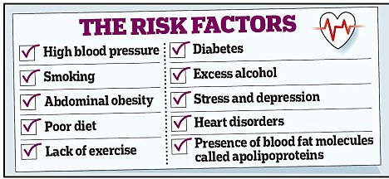
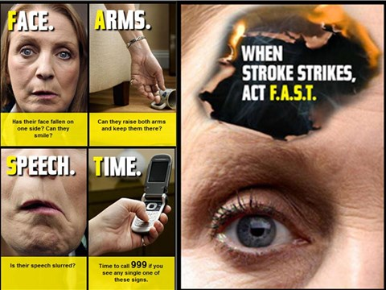
Malfunctions of control and regulatory systems
Monitoring, treatment and care needs:
Medication:
Alteplase - dissolves blood clots and restores blood flow.
Aspirin – antiplatelet that reduces the chance of another clot forming, if taken regularly.
Warfarin – anticoagulant for long-term use, prevents clots forming.
Beta-blockers – medication to treat high blood pressure.
Statins – used if cholesterol is too high.
Surgery:
Thrombectomy – removes blood clots and restores blood flow to the brain.
Surgical stents
Supportive Treatments:
Feeding tube – if difficulty swallowing
Mobility aids – like walking frames, walking sticks etc.
Physiotherapy
Treatment and lifestyle changes:
These help to manage symptoms and reduce the chances of problems. PIES impact on being able to complete daily living tasks. For example; emotional and social impacts due to incontinence or depressions – angry outbursts and fatigue. Inability to control emotions as a result of damage to the brain following a stroke.
Stroke:
Symptoms and effects:
Face: face may have dropped on one side.
Arms: they may not be able to lift both arms and keep them there,
Speech: persons speech may be slurred or garbled or not able to talk at all.
Biological explanation:
Ischaemic strokes – blood clot blocks the flow of blood and oxygen to the brain – clots form in areas where arteries are narrowed and blocked over time by fatty deposits know as plaque.
Heamorrhagic strokes – also known as a cerebral haemorrhage, happen when blood vessels in the skull burst and bleed into and around the brain.

Slide 9
Biological explanation:
An autoimmune disease – the immune system attacks the myelin sheath in the brain and/or spinal cord.
Myelin sheath becomes inflamed in patches – this disrupts the messages travelling along the nerves.
The disruption leads to signs and symptoms of MS.
When inflammation clears – scarring is left behind on the Myelin sheath. Eventually this can lead to permanent damage to the underlying nerves.
Possible Causes:
Thought to be caused partly by genes and partly by external factors – not directly inherited, 2-3% chance of developing it if related to someone with it.
Smokers are twice as likely to develop MS.
Viral infections such as glandular fever may trigger the immune system and lead to MS in some people.
Low Vitamin D levels play a role in the condition, however it is not clear if Vitamin D supplements can help prevent MS.
Monitoring, treatment and care needs:
Progresses with phases of severe symptoms and periods with remission. Many can lead normal lives for a number of years – others rely on wheelchairs and daily care.
No cure, symptoms are treated – steroid medication in relapses, supported by specialist MS team, physio, neurology specialist and or speech and language specialists based on their needs.
Symptoms

Slide 10
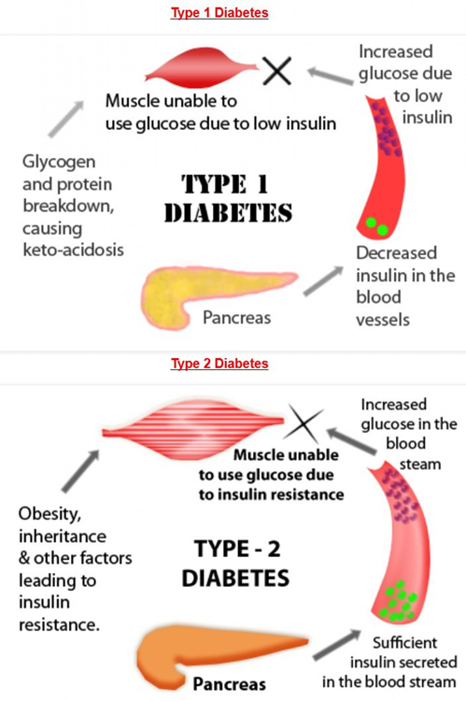
Symptoms and effects:
Feeling thirsty, tired, weeing more often that normal, unexplained weight loss, blurred vision, wounds and cuts heal more slowly cans also have more episodes of thrush.
Long-term complications – vision loss, blindness, kidney failure and lower limb amputation.
Biological explanation:
The hormone insulin is produced in the pancreas (a large gland situated behind the stomach).
Insulin controls the body’s glucose levels by moving glucose from the blood into the body cells – it is then converted to energy.
Type 1 Diabetes:
Autoimmune – the body’s immune system attacks and destroys the cells that produce insulin.
Type 2 Diabetes:
Happens when the body’s production of insulin is not enough to control the glucose levels.
This results in the glucose staying in the blood and is not used as fuel for energy.
If left untreated – can cause organ damage.
Possible Causes:
Overweight or obese – risk factor for Type 2. Research found that fat around the abdomen releases chemicals that can upset the body’s cardiovascular and metabolic system.
Having a relative with either Type 1 or Type 2 can be a risk factor – the close the relative, the bigger the risk.
Age – the risk increases, the older we get, particularly as weight is gained and exercise decreases.
Monitoring, treatment and care needs:
Both Type 1 and Type 2 diabetics have to monitor their glucose levels – usually regularly check their own blood glucose levels.
Due to the risk of retinopathy – diabetics have to attend regular eye screening appointments.
Type 1 diabetes – insulin has to be injected multiple times a day.
Type 2 diabetes – normally health diet controlled, regular exercise and maintaining a healthy weight. Sometimes tablet controlled and sometimes glucose levels will need checked.

Slide 11
Nephrotic Syndrome:
Liver disease: Cirrhosis
Symptoms and effects:
Oedema – swelling of body tissues.
Passing high levels of urine.
Greater chance of catching an infection, due to loss of protein and antibodies.
Blood clots – because the proteins that help prevent clots are passed out with the urine.
Biological explanation:
Kidneys don’t work properly – causing large amounts of protein to leak into the urine.
Loss of protein through the kidneys (proteinuria)
as there is greater permeability of the filtering membrane (glomerulus) due to kidney disease. This results in low levels of protein in the blood (hypoalbuminemia) – causing water to be drawn into tissues – causing oedema.
Symptoms and effects:
Nausea, weight loss, vomiting blood, loss of appetite, jaundice, swelling in legs, ankles, feet and abdomen, itchy skin, confusion, insomnia and memory problems.
Biological explanation:
Alcohol-related liver disease – Cirrhosis is the scarring of the liver caused by long-term liver damage. Scar tissue replaces healthy tissue and prevents the liver form working properly – can lead to liver failure.
Haemochromatosis – faulty gene allows the body to absorb excess levels of iron from food – causing a build up of iron over time and the excess being deposited in the liver, joints, pancreas, heart or endocrine system.
Non-alcoholic fatty liver disease – build up of fat in the liver cells – liver can become inflamed, scar tissue can form around the liver and nearby blood vessels – leading to cirrhosis and eventually failure.
Possible causes:
Alcohol misuse – regularly drinking large amounts of alcohol in a short space of time or more than the recommended limits over many years.
Hepatitis C infections for a long time.
Obesity – cause of non-alcohol fatty liver disease.
Monitoring, treatment and care needs:
No cure for cirrhosis, however, symptoms can be managed.
Lifestyle changes – cutting down or stopping drinking alcohol and aiming for a healthy weight.
A transplant will be the only option if the liver damage becomes extensive and the liver fails.
Possible causes:
Sometimes occurs as a result of kidney damage, caused by another condition – for example sickle cell anaemia or diabetes and infections like HIV, hepatitis and syphilis.
Can also occur as a result of certain types of cancer – leukaemia, myeloma or lymphoma.
Congenital nephrotic syndrome – usually caused by an inherited faulty gene.
Monitoring, treatment and care needs:
Diagnosis normally occurs in childhood (2-5 years)
Main treatment is steroids (side effects are significant)
Blood tests and biopsy are needed so kidney tissue can be examined under a microscope.
Diuretic tablets – increase the level of urine produced – helps to reduce the build up of fluid.
A reduction of salt in the diet prevents water retention.
Vaccinations to prevent infections.
Urine monitored daily with a dipstick – this is to check for relapses.
In some cases, doctors recommend surgery to remove both kidneys - which means the individual is dependent on dialysis until they receive a kidney transplant.

Slide 12
Impacts on lifestyle and care needs of control and regulatory systems
Exam Tips:
Be able to label diagrams of the structure of the nervous system and the brain and make sure you can describe the functions.
Ensure you know how a synapse functions – memorise the process and be able to write a flow chart to remember the stages.
Can you name each gland in the endocrine system and the hormone that it secretes.
Be able to give an example of homeostasis feedback mechanisms for regulating a body condition.
Be able to describe the symptoms, effects and treatments for each condition do that you can use the correct terminology in exam questions.
In general:
Medication side-effects.
Regular check-ups and monitoring appointments, for example; dialysis, urine monitoring, eye-screening for diabetics.
Recovery from or waiting for surgery.
Waiting for a transplant – kidney and liver.
Dietary changes such as healthy diet, salt reduction or stopping smoking and / or drinking.
Could have mobility issues and become housebound.
Having to have the home adapted for mobility issues, like; grab handles, stair lift, handrails etc.
Loss of independence as need assistance.
Driving and walking may be affected, this may also affect the ability to work.
Treatment having emotional side effects like; fatigue, stress or anger about the treatment or the side-effects.
Social and emotional effects – depression, isolating themselves socially and not going out, stopping taking part in activities and hobbies.
Revision Activities:
Draw and label a brain, in a different colour explain the functions of the brain.
Draw and label a neuron – now label and describe the functions of a neuron.
Create a flowchart to show an example of homeostasis.
Look at a charity website for one of the malfunctions – what kind of care and support does it offer?
Receiving appropriate treatment and making lifestyle changes can help people to remain active – managing their symptoms and minimizing the effects of their condition. This in turn allows them to continue to work and live a full and active life.
Charities:
Charities can help individuals in so many ways;
Providing information and support to individuals and families to maintain their independence.
Supporting individuals coping with the impact of illness or a condition.
Opportunities to meet others in a similar situation – Stroke Association, Kidney Care Uk, British Liver Trust and Diabetes UK to name a few.

